Slide 1

Ancient India

Slide 2
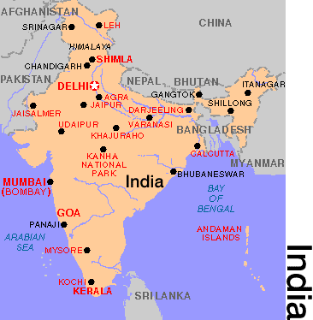
Geography of India
India is considered a “subcontinent” because of its size. It is actually a part of Asia. In the north are high mountains, the Himalayas and Hindu Kush. In the center is the Deccan Plateau.
Hindu Kush Mts.
Himalayan Mts.
Deccan
Plateau

Slide 3
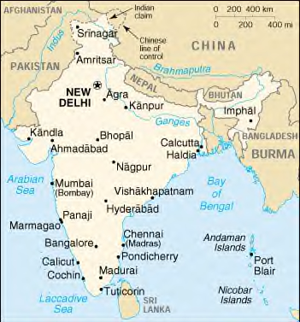
Indus Valley
The Indus River is located in Pakistan. Find it on the map. It was along this river that a civilization developed around 2,500 BCE. It is called the Indus Valley Civilization. Two major cities of this civilization were Harappa and Mohenjo-Daro.

Slide 4
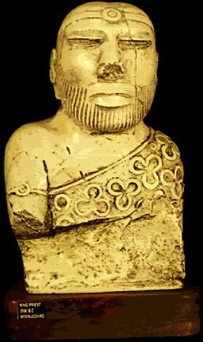
The Indus Valley Culture
The people of the Indus Valley were mostly peaceful farmers. They built large cities with ordered streets and bricks made all the same size. This indicates they had a strong central government. This statue is probably a priest or king.

Slide 5
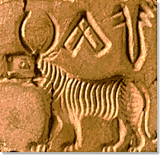
The Indus Valley people had an advanced civilization with large cities, running water and sewer systems. They built walls around their cities which indicated that they might have had to defend themselves against other people. We do not know a lot about them because we cannot yet read their writing.
The picture at the right shows an example of Indus Valley writing. Linguists are still trying to decipher the language. We know they traded with the people of Mesopotamia and Egypt so perhaps those people knew how to read and speak this language!

Slide 6
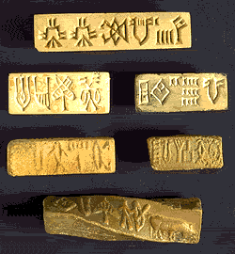
Indus Valley Script
Here are several examples of Indus Valley writing. It is believed that the Indus Valley people may have also written on palm leaves or cloth but no evidence of this has survived.

Slide 7
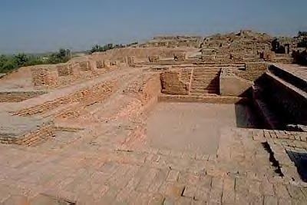
This is a photograph of “The Great Bath” at Mohenjo Daro. This is one of the earliest examples of a public bath or water storage system found in the world. The Indus Valley people were great architects and city planners.

Slide 8
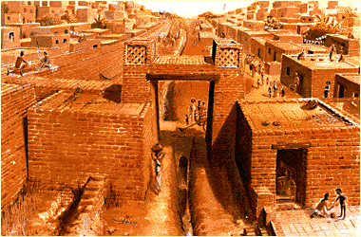
Here is a reconstruction of what the entrance to Mohenjo Daro might have looked like.

Slide 9
Aryan Invasion
Around 1500 BCE, a group of nomadic warrior-herders crossed the narrow Khyber Pass in the Hindu Kush Mountains and invaded the Indus Valley culture. These people, the Aryans, came from Eastern Europe between the Black Sea and Caspian Sea, probably looking for pastures for their animals. Flooding and earthquakes had weakened the Indus Valley culture and they were unable to withstand the newcomers.

Slide 10

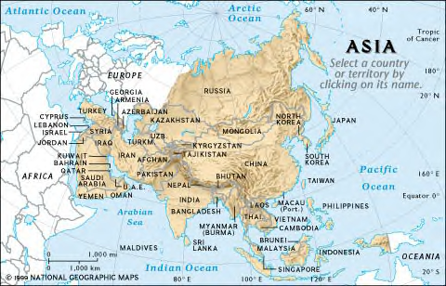
Aryan Invasion
The route of the Aryans into India.

Slide 11
The Aryans brought with them their own language, called Sanskrit and religious and cultural beliefs. The Indus Valley people eventually became intermixed with the Aryan people and the two cultures together make up what is now much of the culture of modern India. Hinduism, the major religion of India, was a mixture of Aryan and Indus Valley beliefs. The caste system, which keeps people in strict social classes, was brought to India by the Aryans.
Two Cultures Combine

Slide 12
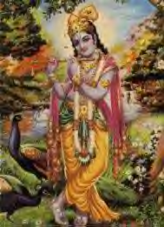
Hindu Religion
The Aryans and the Indus Valley culture eventually produced what is known today as Hinduism. This religion is polytheistic, which means believing in many gods. We know about this ancient religion because of Aryan books called “Vedas” that record the beliefs of the Aryans. Pictured here is one of the many gods of Hinduism, Krishna.

Slide 13

Hinduism
Hinduism differs from other religions like Christianity, Judaism and Islam in that there is no one single founder or one set of beliefs that must be followed. There are thousands of Hindu gods and goddesses in Hinduism. Most of the beliefs of Hinduism came from the oral traditions of the Aryans which became the Vedas—or holy writings—of the Hindus.

Slide 14

Reincarnation
Central to Hinduism is the belief in reincarnation. Hindus believe that after a person dies, they will be re-born as some other creature or thing. What you are re-born as depends on your “Karma” or the deeds you did in your previous life. If you did good deeds, you will reborn into a higher, better life. If you had bad Karma, you may be re-born as an insect or even a tree.

Slide 15

Caste System
One social custom brought to India by the Aryans was the caste system. This system put every person in society into a certain class from which they could never advance. The caste system was very effective in keeping social order but it was rigid and strict. Those in the lowest caste were looked down on by upper caste members and could never change castes.

Slide 16
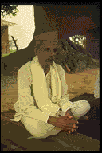
Caste System
India’s caste system is divided into many different classes, each with its own job. The highest class is the Brahmans, or priests. They have great authority and respect.

Slide 17
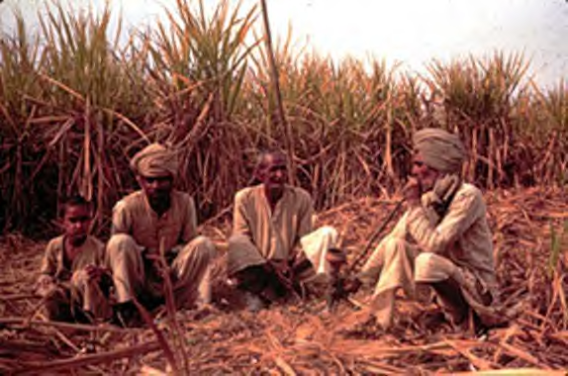
Caste System
The next level are the warriors, or land-owners. They are often in the wealthy, ruling class. In early times, they were the armies for the many princes of India. They are called Kshatriya

Slide 18
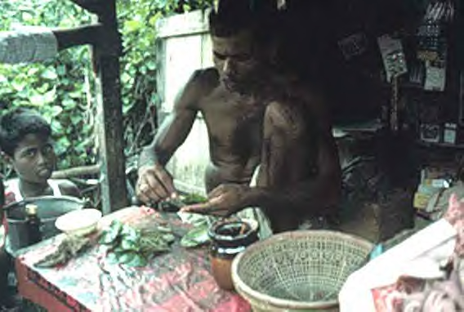
Caste System
The Vaishya are the merchants and artisans. They are the people who sell products. They, like all members of each caste, cannot ever change their caste.

Slide 19
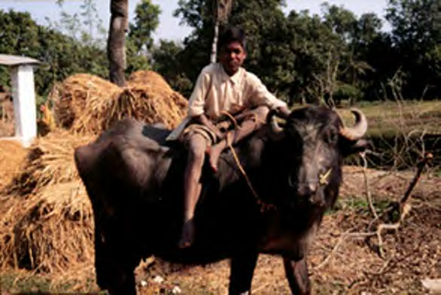
Caste System
The lowest level are the artisans and farmers. They are called Shudra. They are very important because they provide food and goods for society. Like members of every caste, they must marry within their own caste.

Slide 20
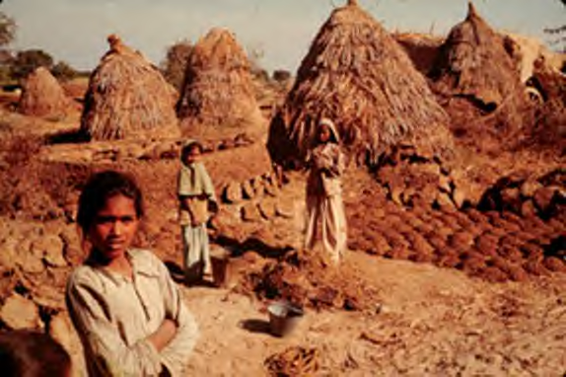
Caste System
The lowest group in India are the Harijan. They are also called the “untouchables” or “outcasts” because they are not even considered part of the caste system. Their job is to do all the worst jobs in the community such as cleaning latrines and sewers
and sweeping the streets. Members of the caste system were not even supposed to have the shadow of an untouchable touch them. These people believed that the only way to get out of their lot in life was to perform their jobs without complaint so they could be born into a higher caste in the next life.

Slide 21
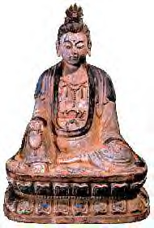
Siddharta Gautama
Around 566 BC, Siddharta Guatama was born into the warrior or Kshatriya caste. He was a prince who was kept isolated inside a beautiful palace and not allowed to see the real world. One day he left the walls of his palace and saw the pain and misery of life. He decided from then on that he needed to find a way of living that would allow people to find peace in life. He spent many years trying different ways of life, following different philosophies. Finally he came up with his own way, which is now called Buddhism. Gautama became known as Buddha, which means “enlightened one.” He developed the Four Noble Truths and The Eightfold Path. These are rules to live by that help people live morally and find the “middle path,” without too much pain, or too much pleasure.

Slide 22
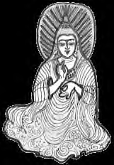
Asoka
Asoka was a famous ruler of India. He became emperor in 268 BC. After fighting a bloody battle, he sickened of war and turned his life in a different direction. He became a buddhist, or someone who followed the teachings of Buddha. He lived peacefully and built roads for travelers, planted trees to give shade, constructed rest houses and dug wells. He considered all his subjects his children and tried to care for them with love and kindness. Many people became buddhist after Asoka’s example.

Slide 23
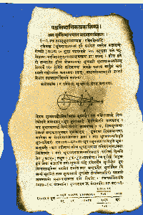
Contributions
Many advances in science, medicine, astronomy, and mathematics came out of India. This is a depiction of an ancient Indian book that predicts eclipses of the sun and moon.

Slide 24
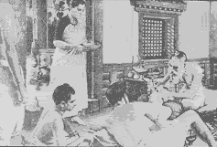
Contributions
India had many advances in medicine. One doctor from Ancient India wrote a book on how he rebuilt noses through plastic surgery. He no doubt needed to do this often since having one’s nose cut off was one of the punishments for committing a crime.

Slide 25
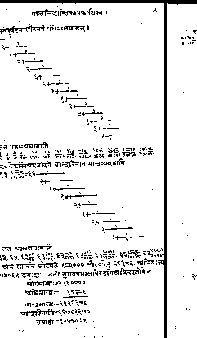
Contributions
This is a sample of elaborate mathematical calculations taken from an Indian text around 600 BC. An Indian named Brahmagupta is credited with inventing the idea of “0”(zero). This changed greatly how mathematics could be used.

Slide 26

Contributions
Ancient India is also credited with inventing the magnetic compass. Indians sailed the Indian Ocean in boats the were guided by a metal “fish” floating in oil. The fish pointed north, acting as a compass for the boats.

Slide 27
Ancient India
Ancient India brought inventions, ideas, philosophies and social and cultural traditions that have spread throughout many of the world’s cultures. This huge subcontinent with its rich and varied history was certainly one of the greatest early civilizations in the world.

